Slide 1
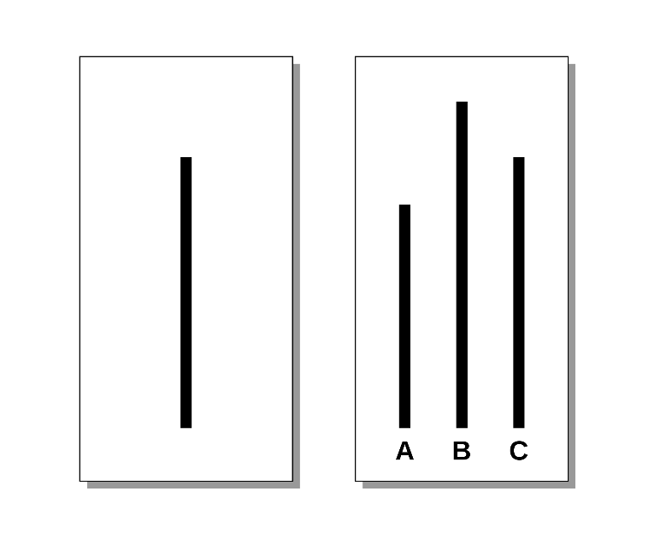
Social Psychology: Conformity and Compliance
Asch Conformity Study (1951)
https://www.youtube.com/watch?v=NyDDyT1lDhA
Milgram’s Compliance Study
https://www.youtube.com/watch?v=eTX42lVDwA4
And … Derren Brown does it
https://www.youtube.com/watch?v=PaHbACoYNSA
http://www.slideshare.net/jbradfo4/bradford-213-lecture-3-four-famous-social-psychology-experiments

Slide 2
The Stanford Prison Experiment Video
1. How did each of the following play a role in the events that occurred during the Stanford Prison Experiment? Define each term and discuss each one in relation to the experiment.
Normative Influence h. Conformity
Informational Influence i. Compliance
Fundamental Attribution Error
Deindividuation
Depersonalization
Diffusion of Responsibility
Locus of Control
Why do you think the Stanford Prison Experiment results were never published in a peer reviewed journal?
Abu Ghraib connection: https://www.youtube.com/watch?v=sZwfNs1pqG0

Slide 3
The Psychology of the Crowd
Fomenting formula:
Point out commonality among those gathered
Stir up emotions of fear and anger
Invoke a higher power, speaker appoints himself the agent of that power
Once crowd ‘buys in’:
Give higher power’s ‘solution’
Proclaim that carrying out the solution is a victory for commonality and higher power
1. Keep the dogma simple. Make only 1 or 2 points.
2. Be forthright and powerfully direct. Speak only in the telling or ordering mode.
3. As much as possible, reduce concepts down into stereotypes which are black and white.
4. Speak to people’s emotions and stir them constantly.
5. Use lots of repetition; repeat your points over and over again.
6. Forget literary beauty, scientific reasoning, balance, or novelty.
7. Focus solely on convincing people and creating zealots.
8. Find slogans which can be used to drive the movement forward.
Gustave Le Bon

Slide 4
Human Subjects Protocol
Informed Consent for participation in scientific research
Goals of study
Benefits of research
Risks involved
Deception
Psychological stress
Invasiveness
Anonymity/Confidentiality
Compensation
Voluntary nature of involvement
Debriefing
Experimenter contact information

